Slide 1
Covenant World Relief Guiding Principles for Relief and Development

Slide 2
Covenant World Relief
We participate in God’s transforming mission in the world through disaster relief and holistic development among the most vulnerable.
Our mission is to love, serve, and work together with the poor, the powerless, and the marginalized.

Slide 3
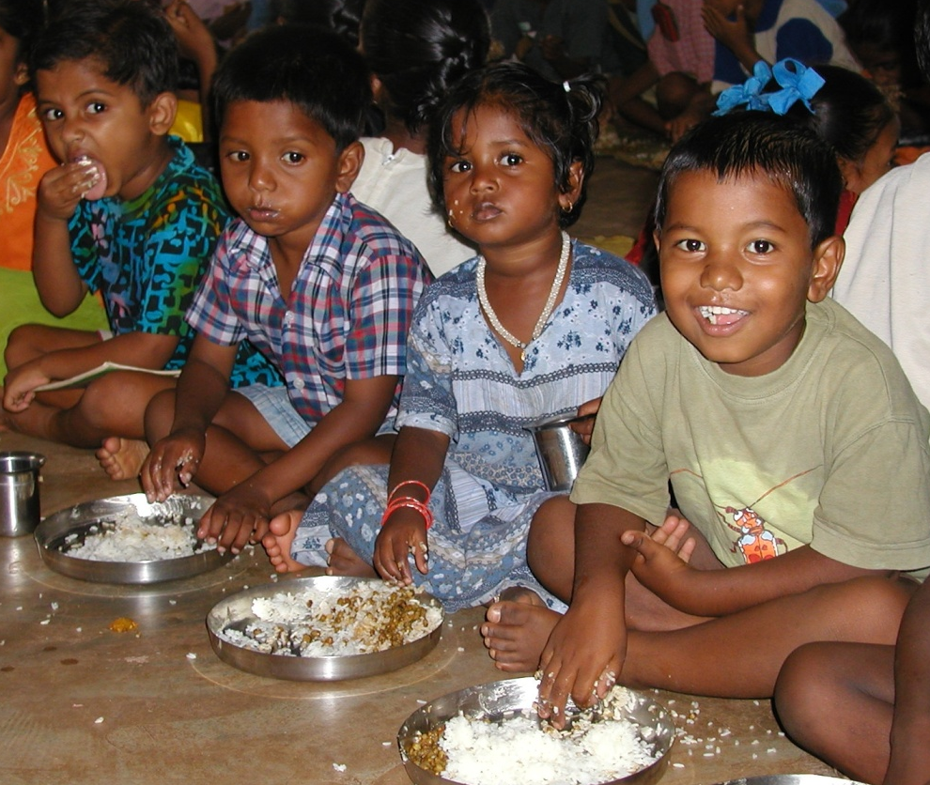
Maintain a Kingdom Perspective and Focus
This is God’s mission in the world—not ours
All are created in the Image of God and worthy of dignity and respect
Clearly demonstrate the message of the Kingdom and the Good News of Christ

Slide 4
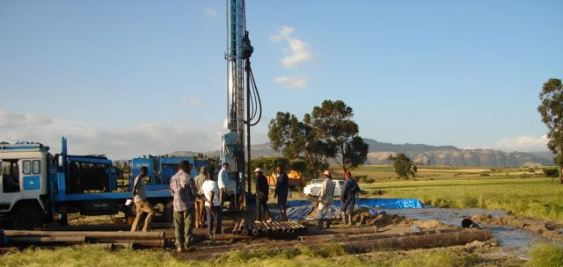
Partner with others
Work in partnership in order to leverage human and financial resources

Slide 5
Involve and empower people from the community
Locally initiated and owned projects that equip and train people from the community
Emphasis is on working with rather than doing for the community

Slide 6
Serve those most in need
Serve the most vulnerable in the whole community
Model Christ’s love for all, regardless of religion, ethnicity, gender or age

Slide 7
Seek transformation of individuals, families, and communities
Importance of long-term, holistic, sustainable development

Slide 8
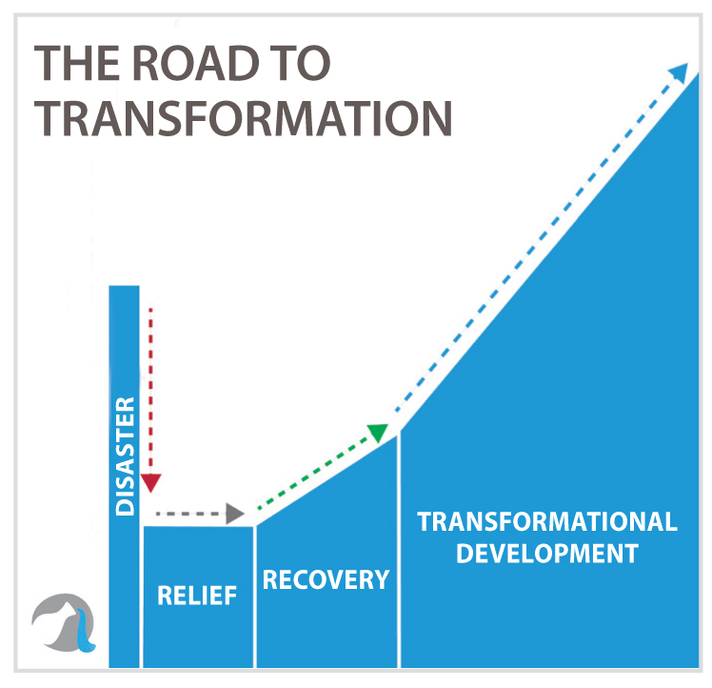
The Road to Transformation

Slide 9
Seek transformation of individuals, families, and communities
Importance of long-term, holistic, sustainable development
Quality of impact is valued more than the quantity of people impacted—depth over breadth

Slide 10
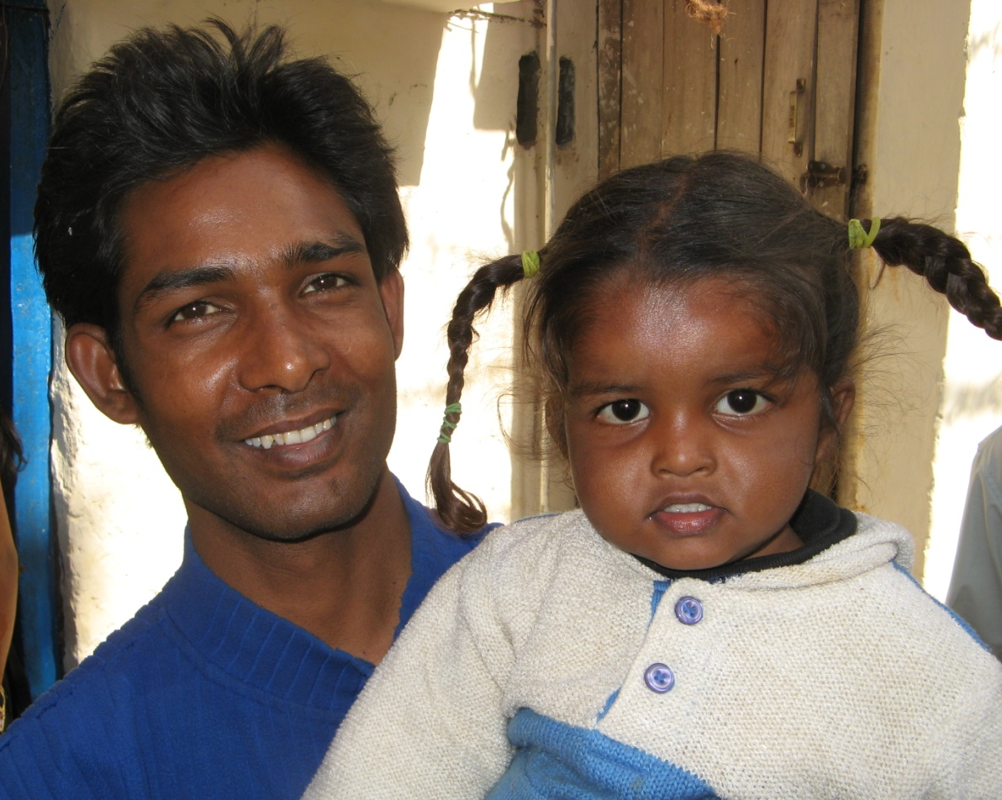
Address root causes, not just symptoms
Seek justice by focusing on systemic issues

Slide 11
Additional Information on the Similarities and Differences of Relief and Development

Slide 12
Relief Development
Disaster Relief vs. Community Development
Short term
Immediate response
Survival
Most resources come from outside
Address immediate needs—stop the bleeding
Long term
Careful preparation
Transformation and sustainability
Local resources and outside resources
Address root causes—seek justice

Slide 13
Commonalities of Relief and Development
Assessment carried out with local leaders
Seek to meet the needs of all people where they are
Serve with compassion and seek justice
Involvement and empowerment of local people
Goal is transformation of all involved
Kingdom focus

