Slide 1
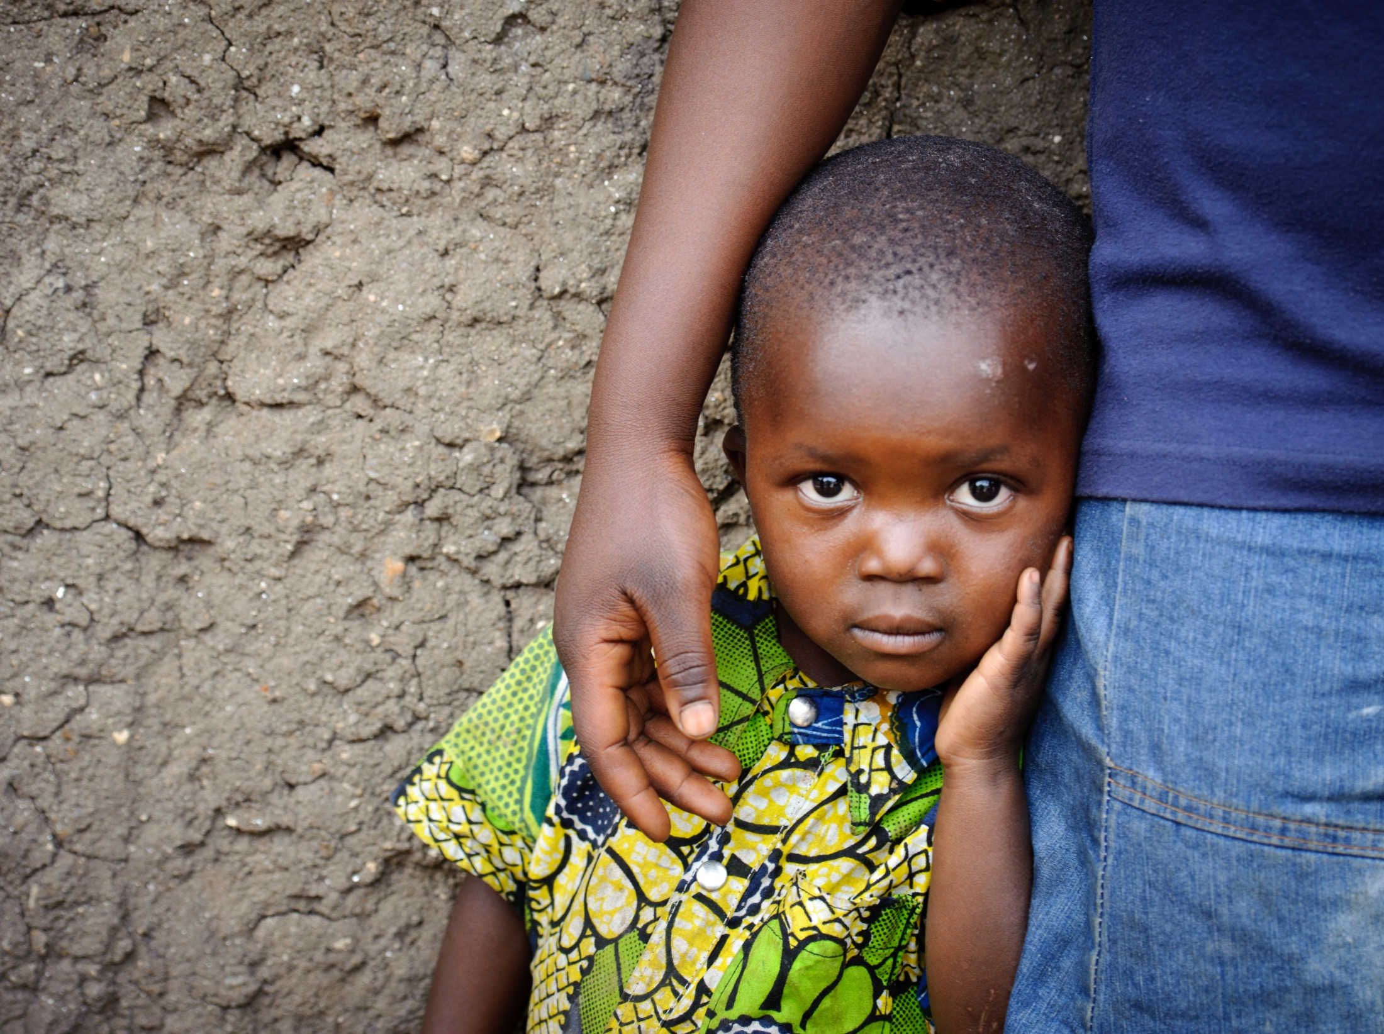

Slide 2
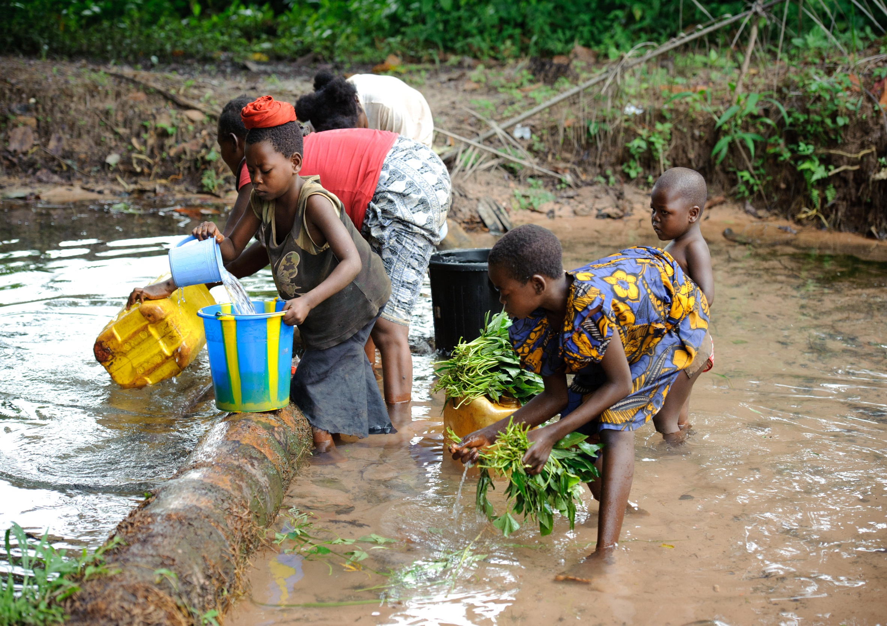
Lord, we pray for our sisters and brothers who struggle to provide clean drinking water to nourish the health of their families. Pour out Your living water upon them and give us generous hearts to support them in building and maintaining new water systems.

Slide 3
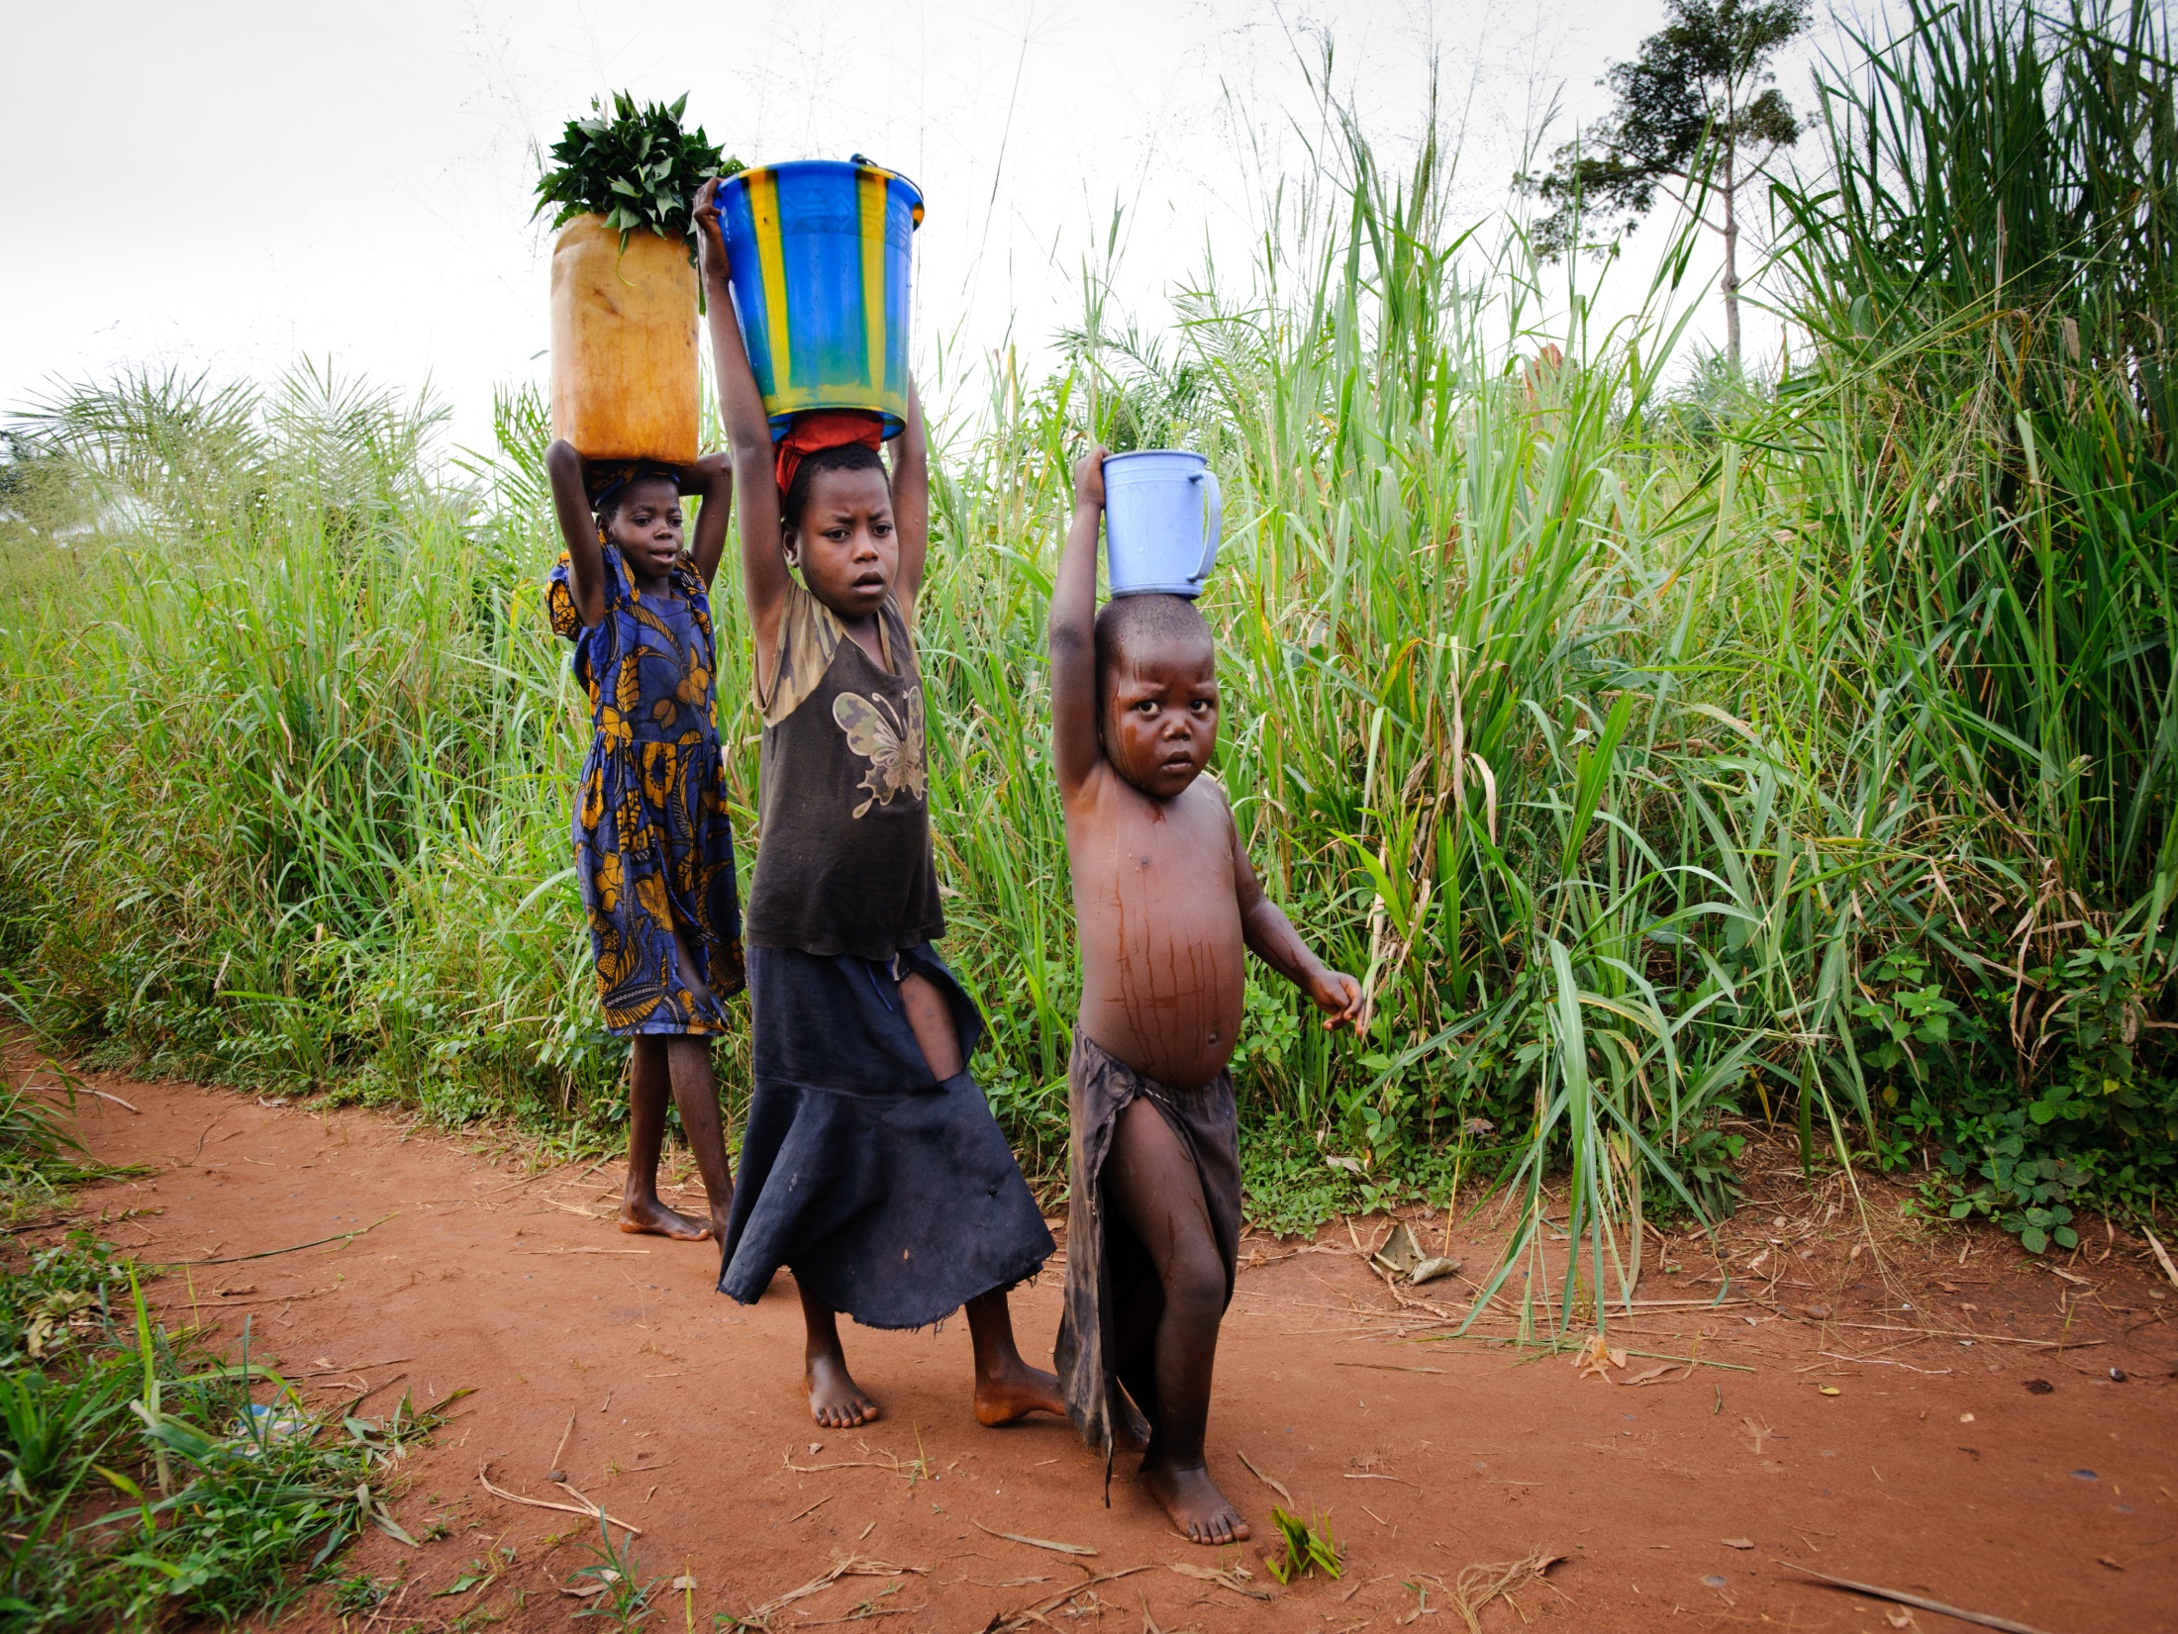
Remembering the woman at the well who gave water to Jesus, we ask Your blessings on those who labor so that others may have a drink. Keep them safe from predators and other dangers. Give them strength for their tasks and hope for a day when their labor won’t be in vain.

Slide 4
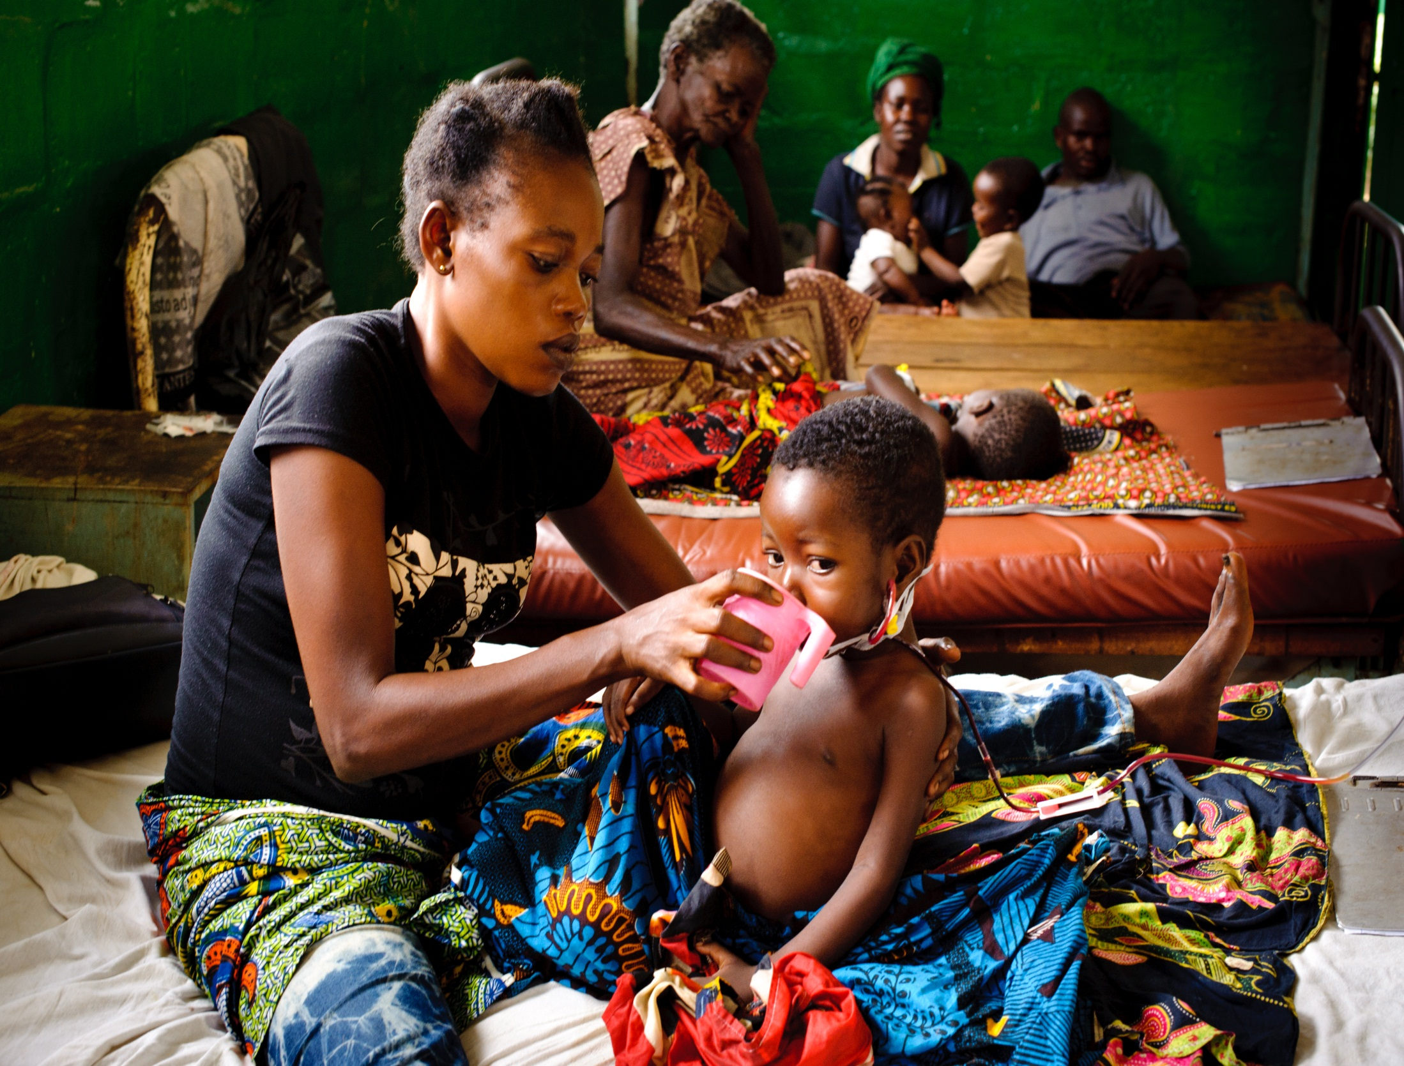
Bring comfort, Lord, to those who suffer indignities and ill health because of poverty and ignorance. Let Your light shine into their lives through us to bring hope and renewal.

Slide 5
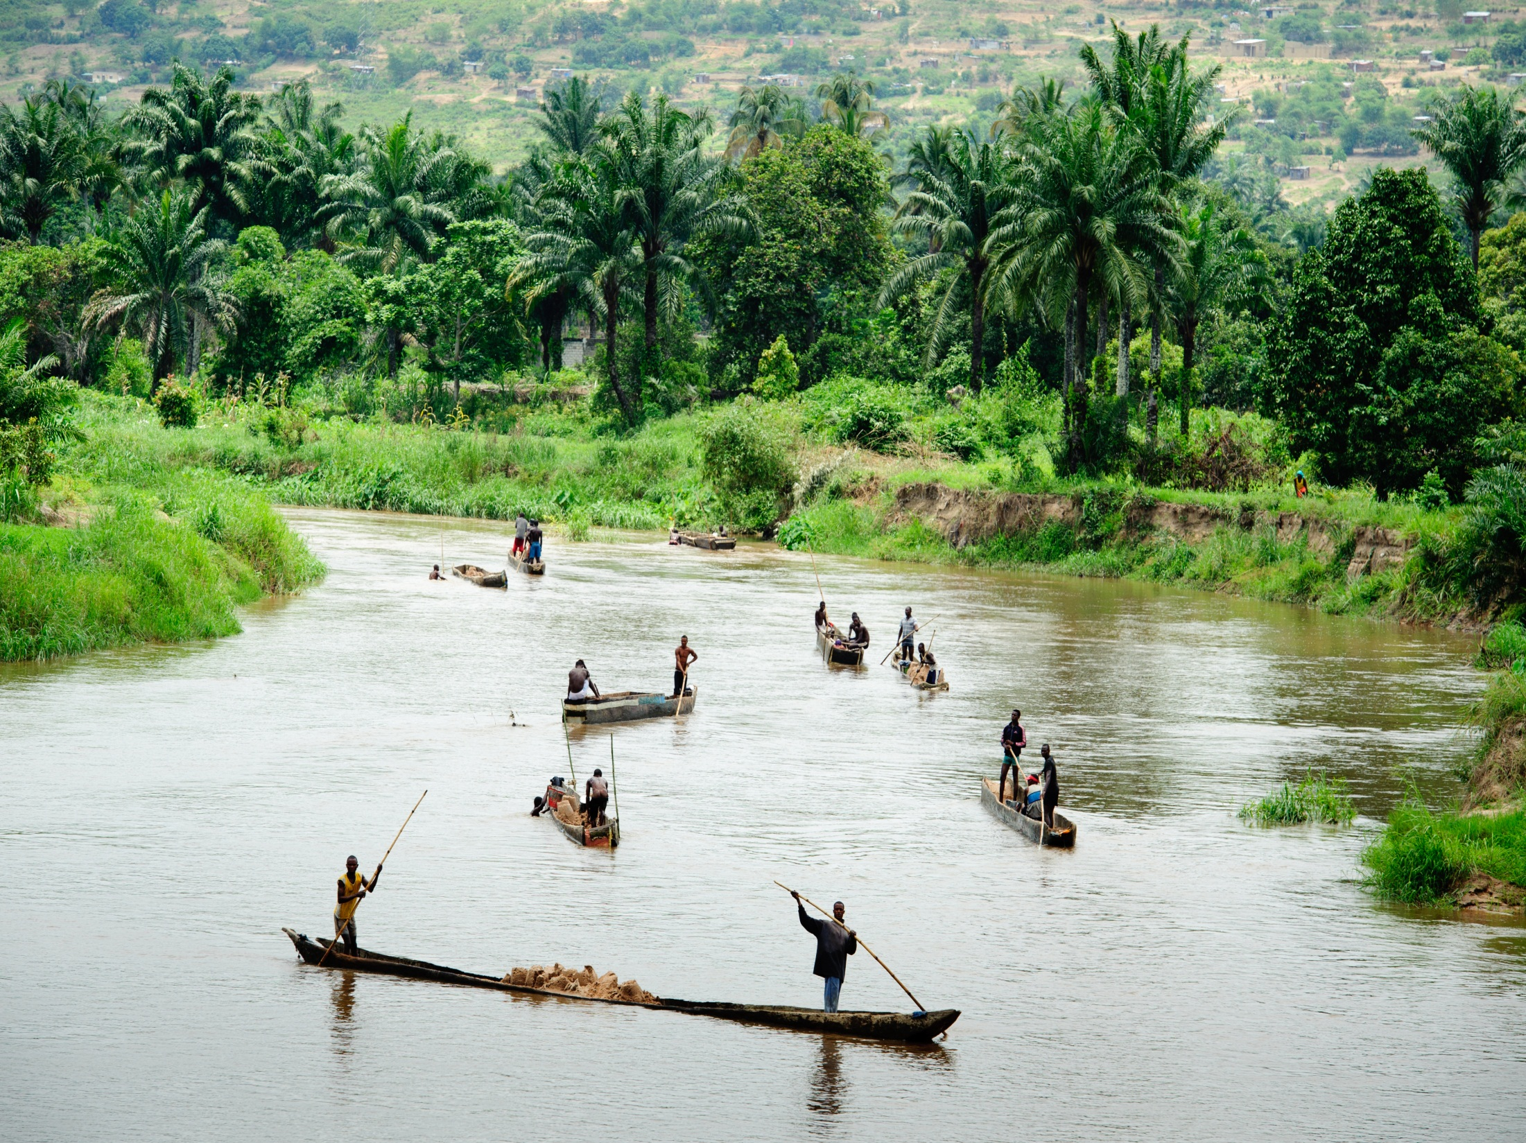
O Lord, we acknowledge that You have entrusted Your bountiful earth to our care. We pray for healthy and fertile lands with wildlife and plentiful rain to support the lives of the Congolese. May they learn to steward the land You have given them and share its blessings.

