Slide 1
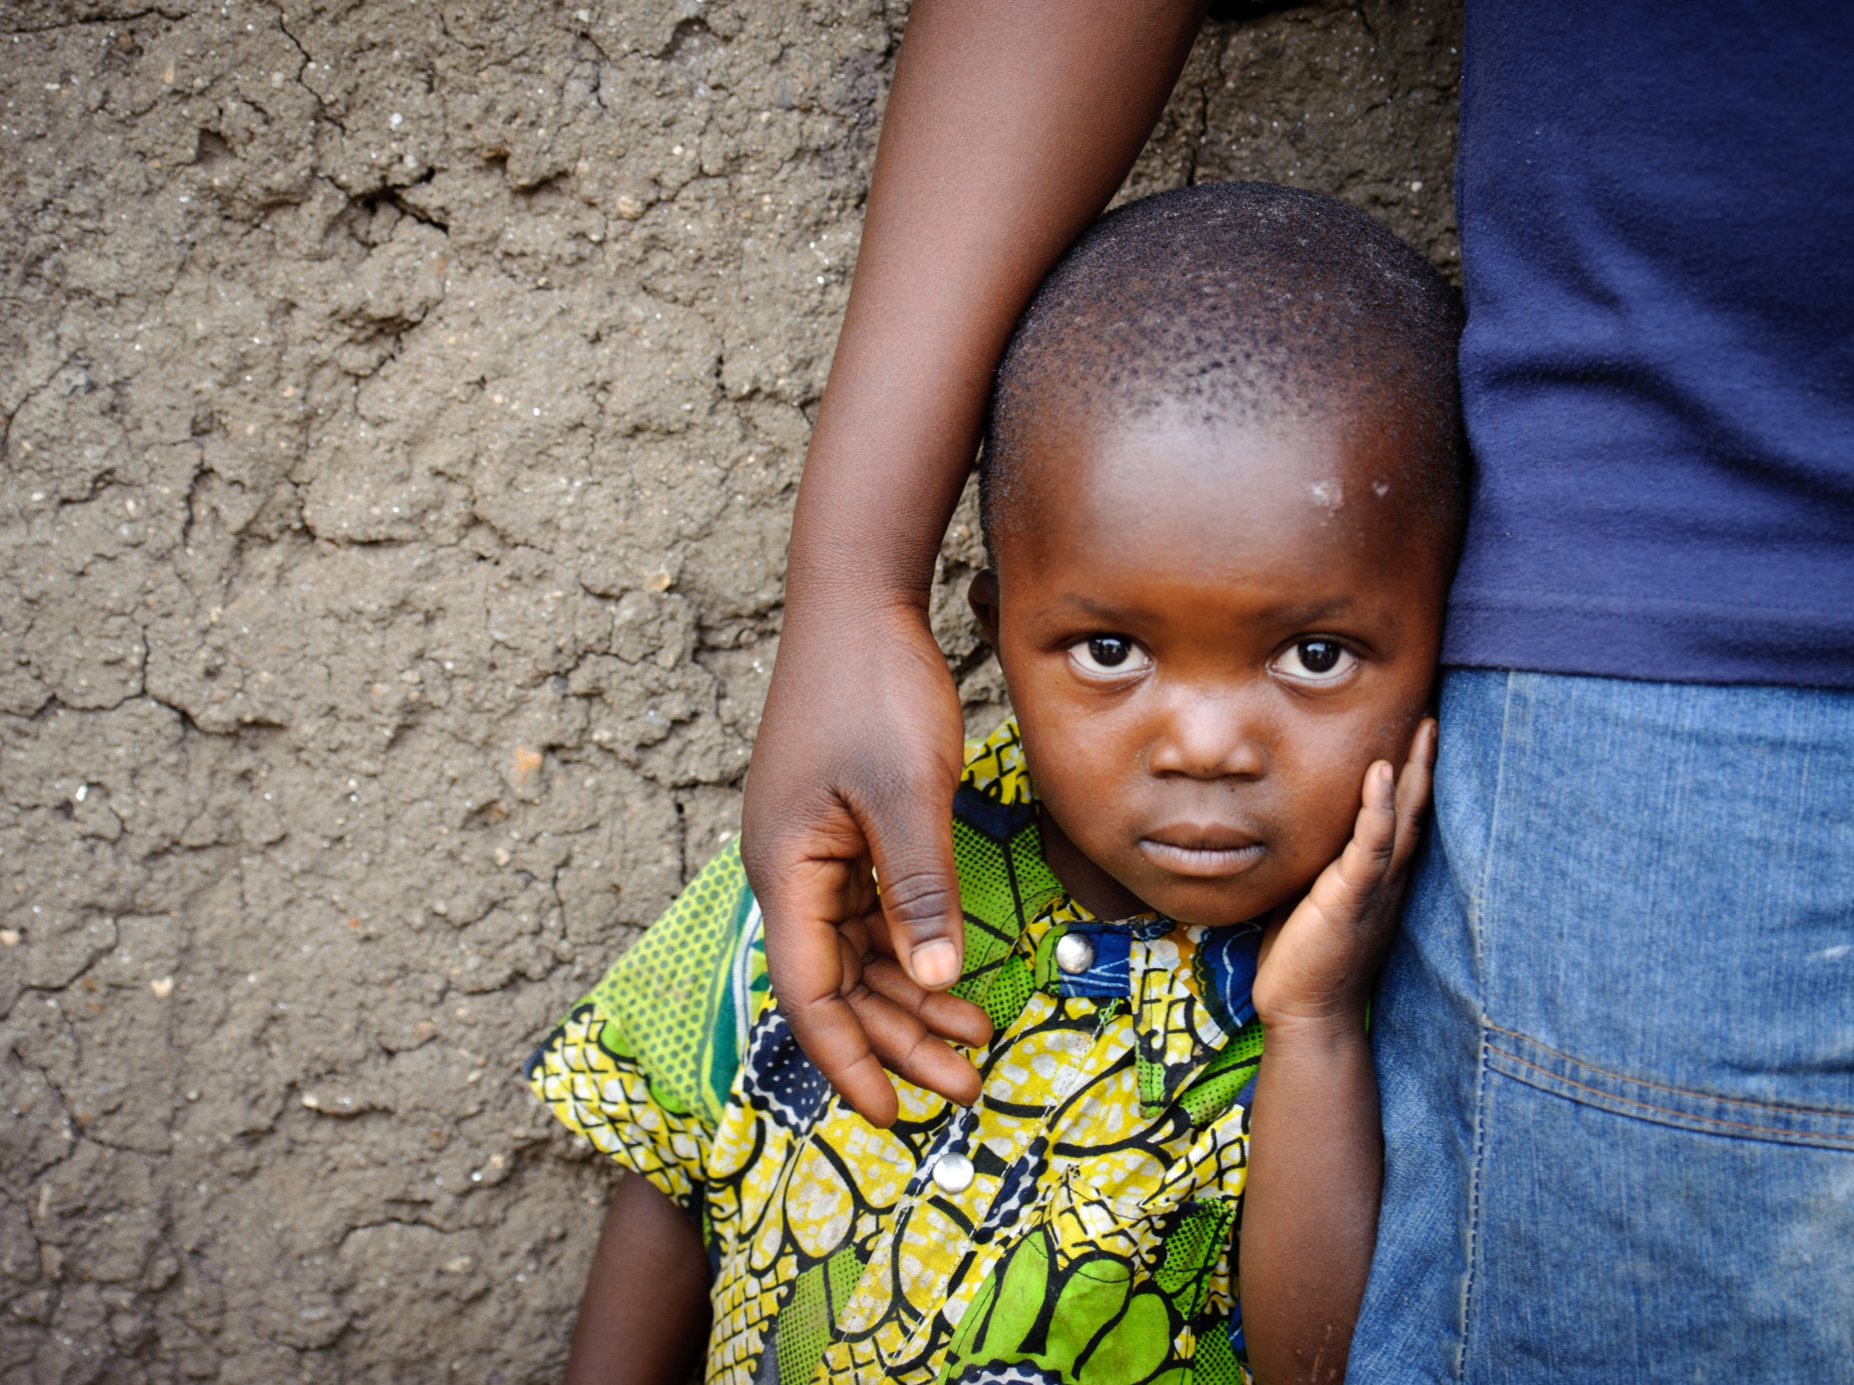



Slide 2
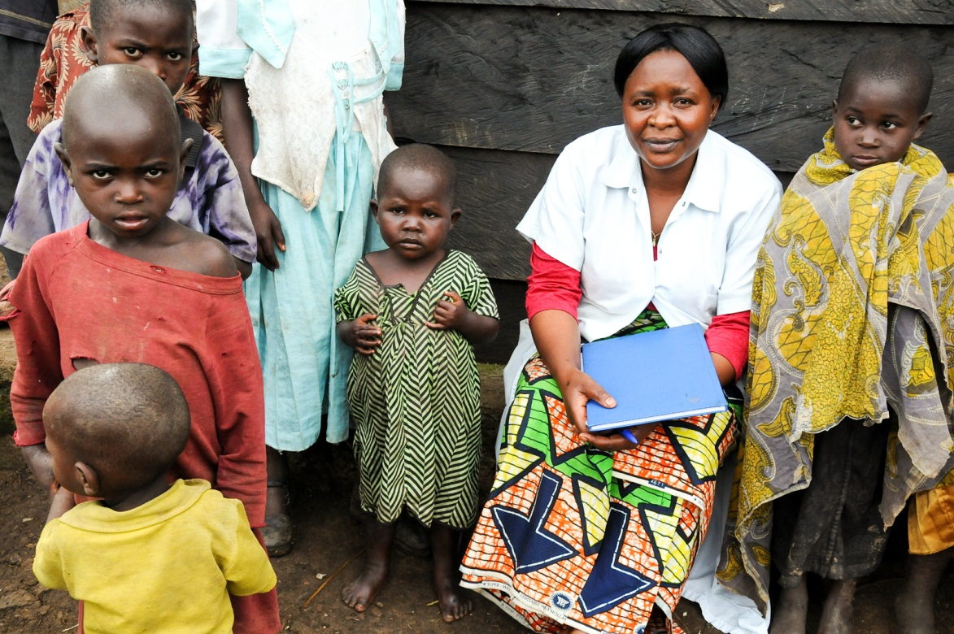
Loving Father, kindle the love of learning in the hearts and minds of parents, teachers, and children. Give them hope for the future and determination to overcome every obstacle that prevents children from attending school.

Slide 3
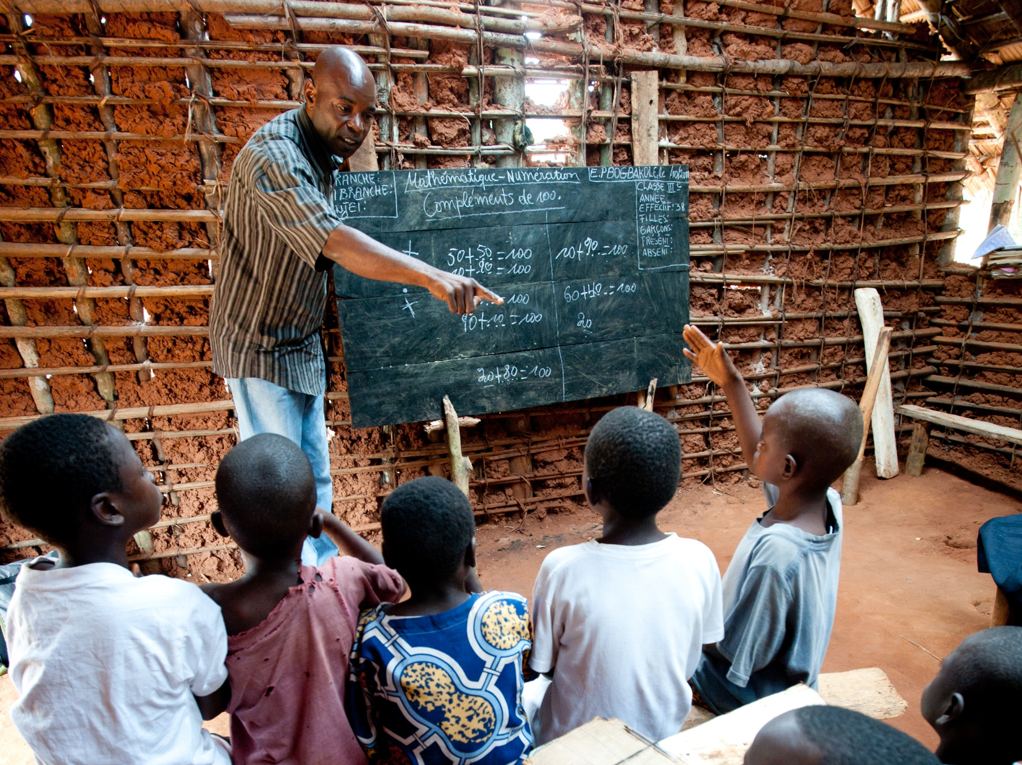
Lord, bless the teachers and the schools of the Congo. May these dedicated educators have everything they need in order for the children to learn and to grow “in wisdom and stature, and in favor with God and man.” (Luke 2: 51-52)

Slide 4
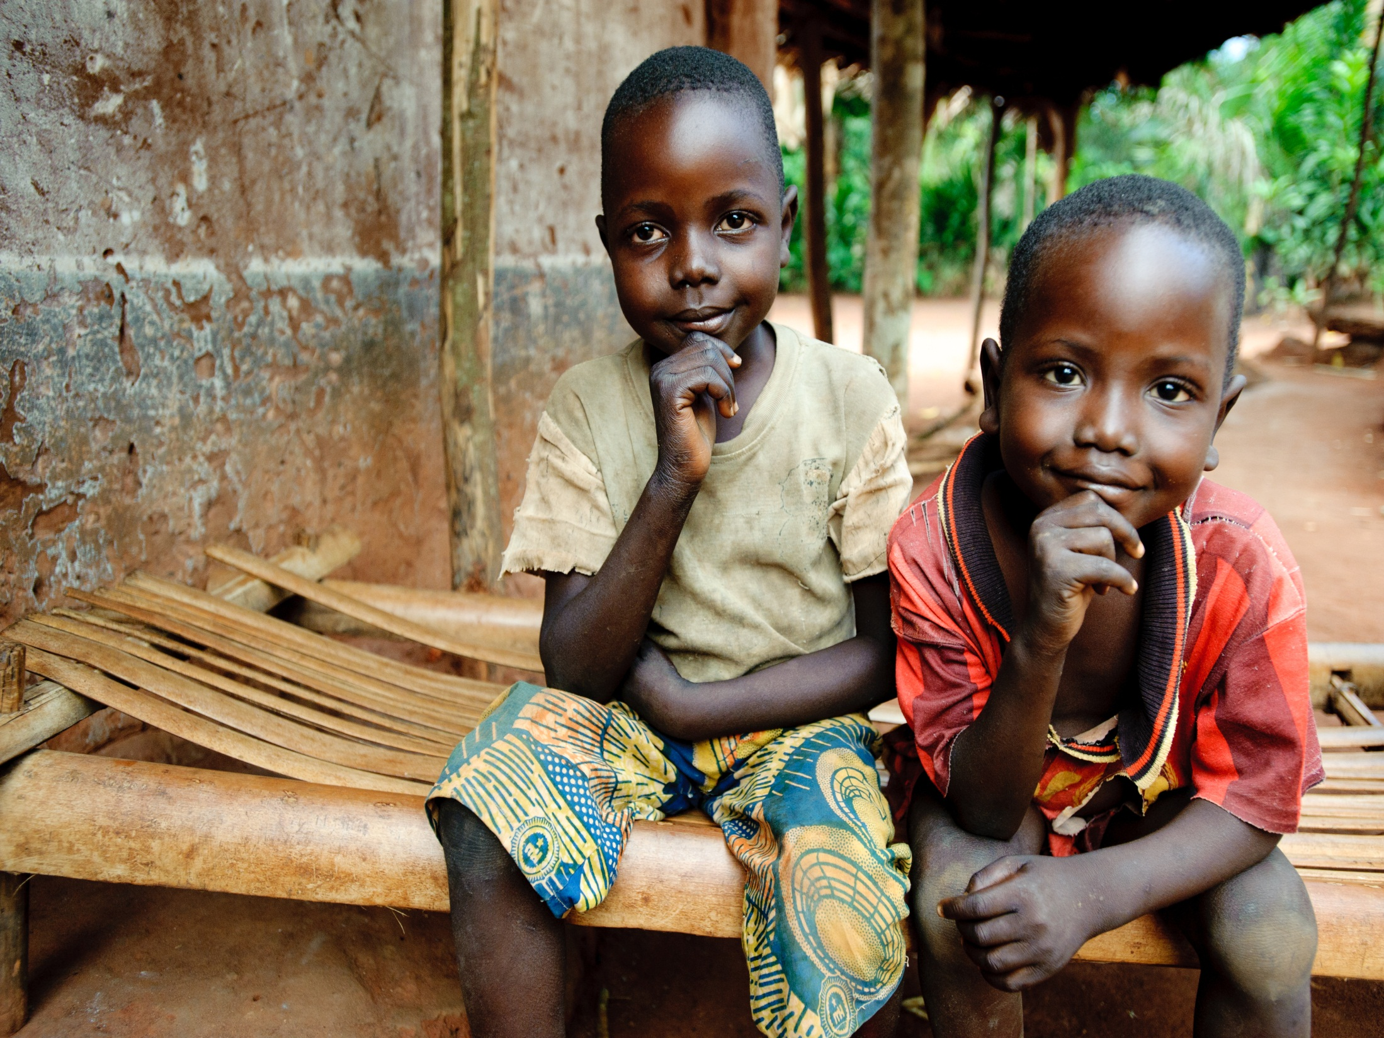
Father, we lift up to You the precious children of Gemena. Strengthen the ability of their communities to keep them healthy and well fed and to educate them for a brighter future.

