Slide 1
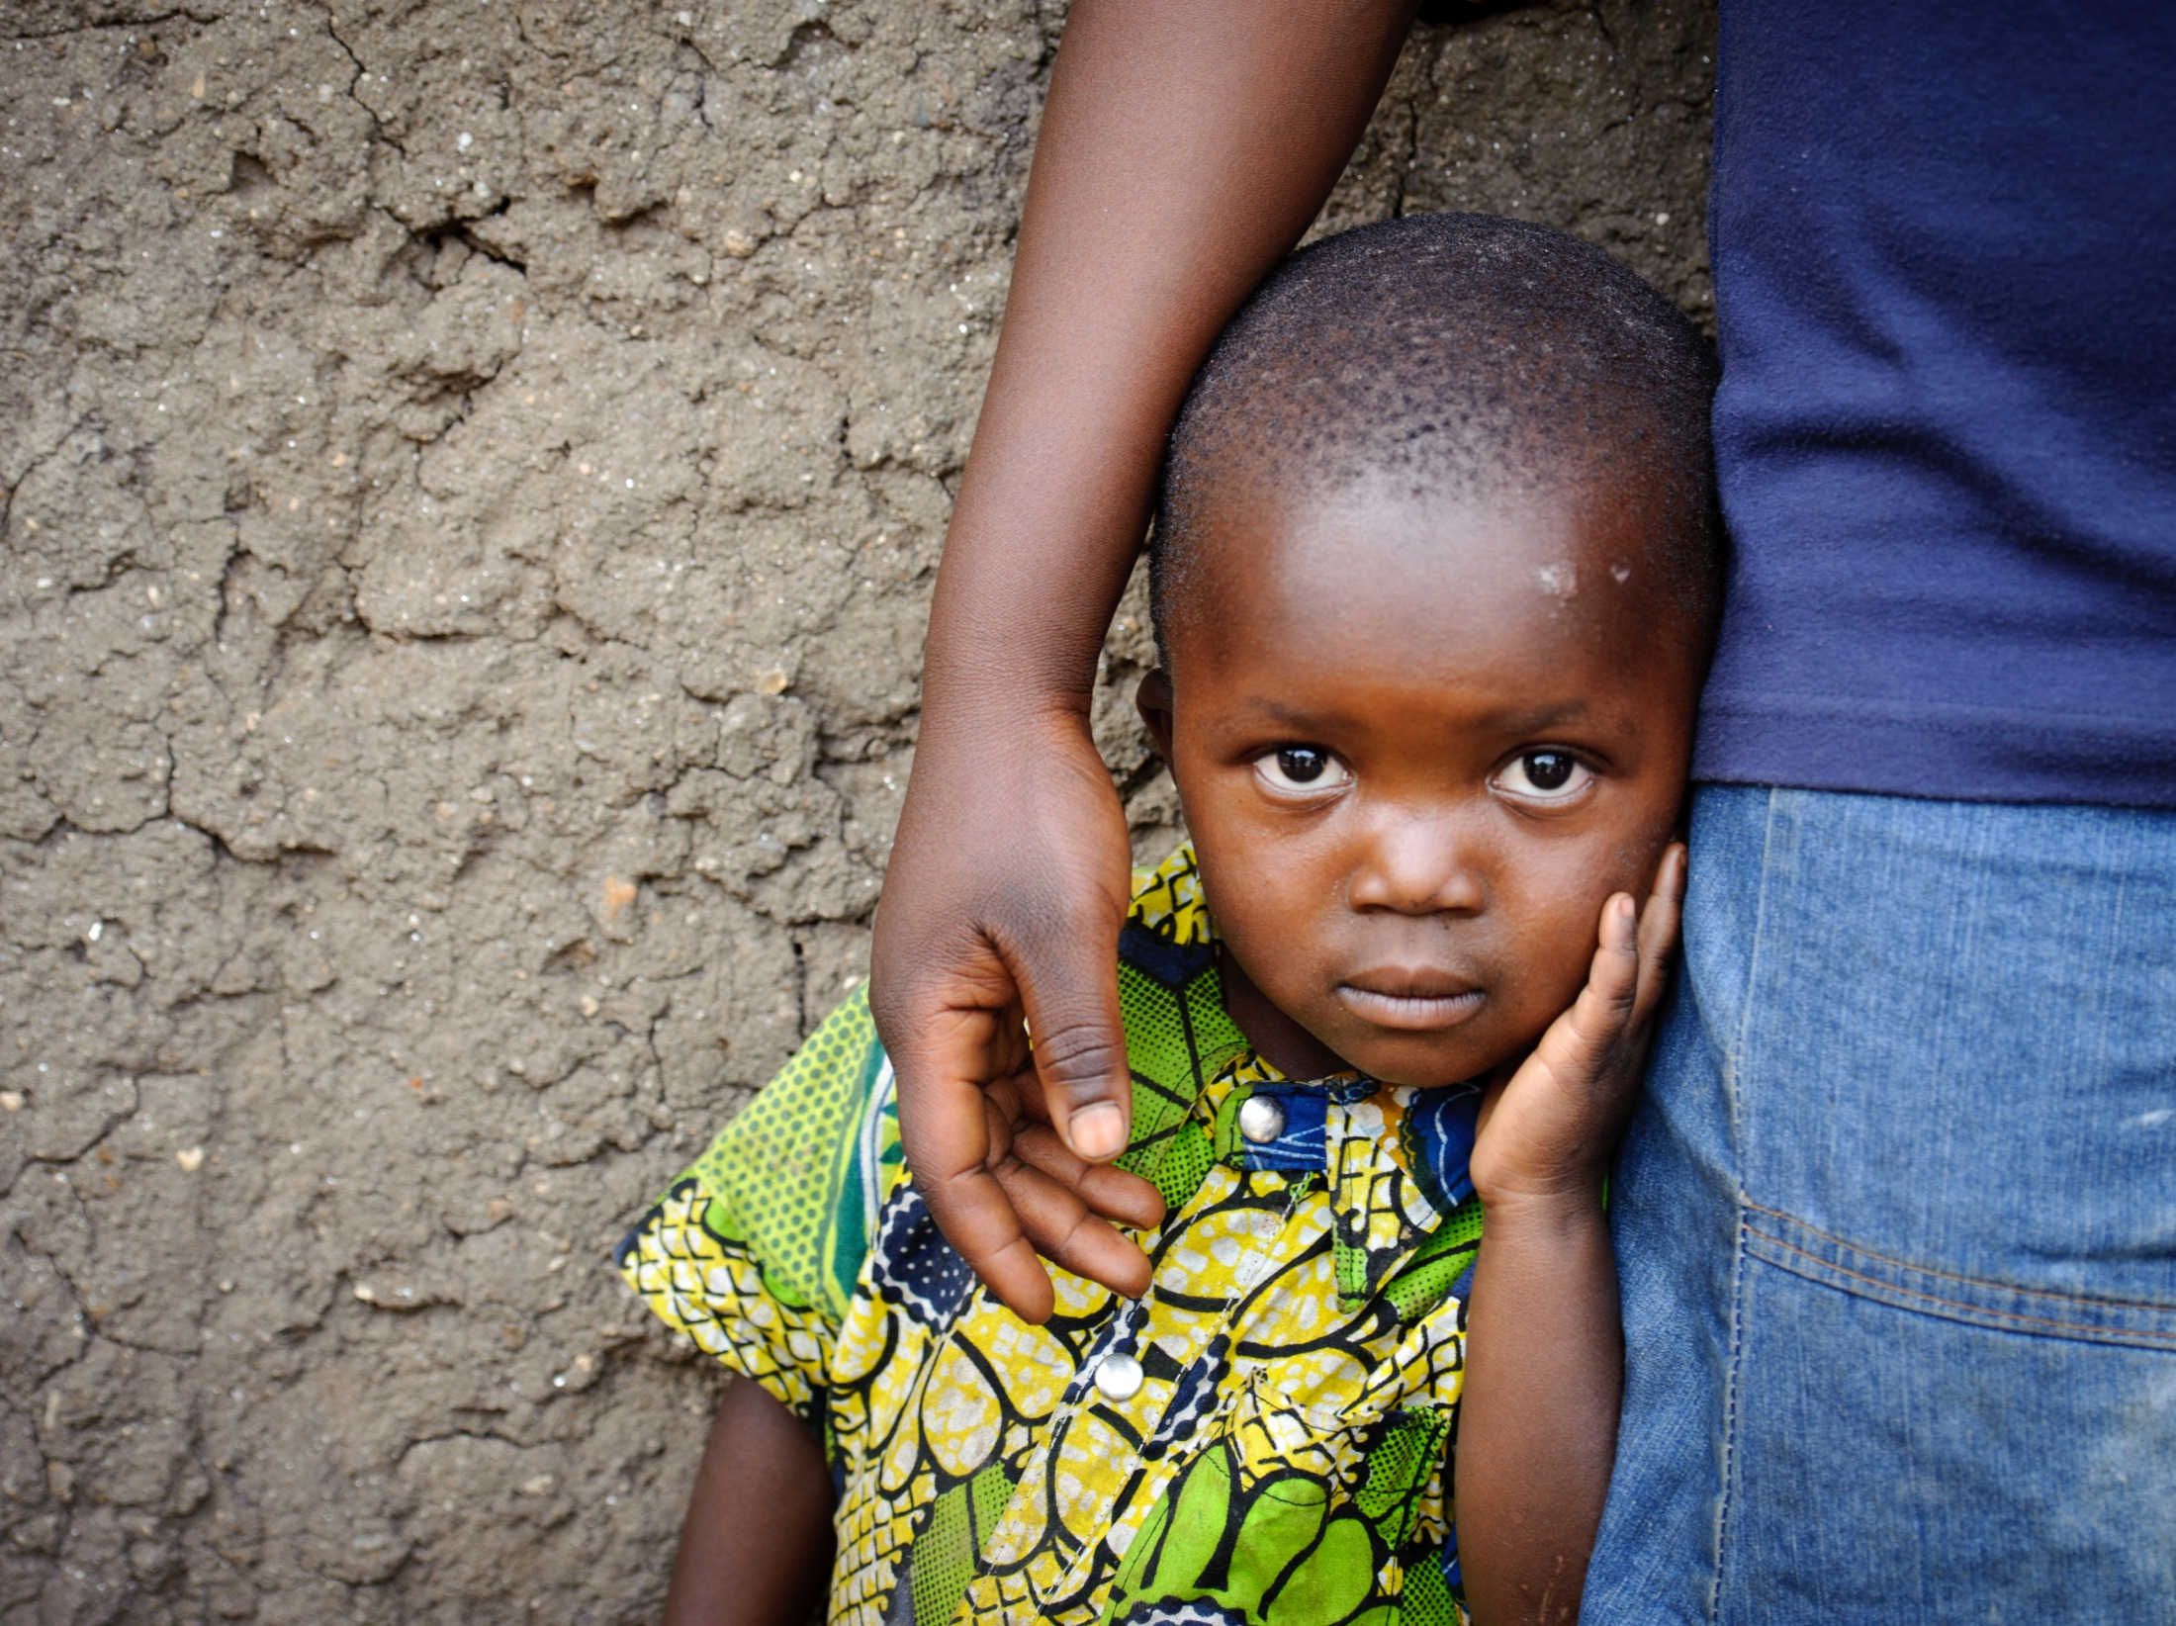

Slide 2
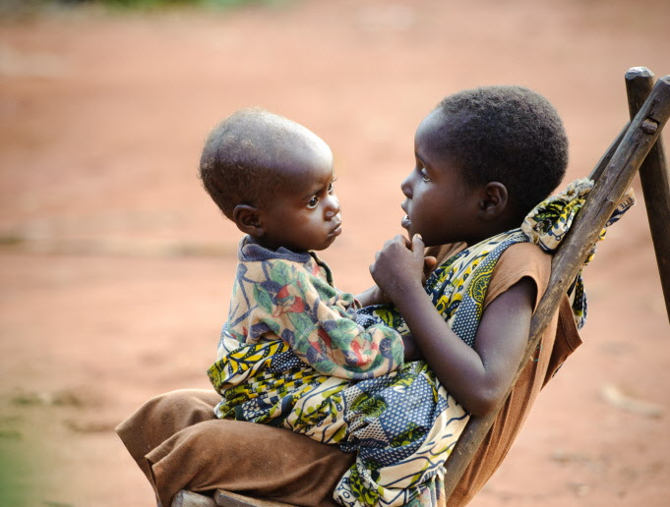
Heavenly Father, your children in the Congo are suffering in a land that you’ve endowed with a great wealth of resources. Bring justice and equity to the land. Strengthen your followers there to be salt and light to those around them.

Slide 3
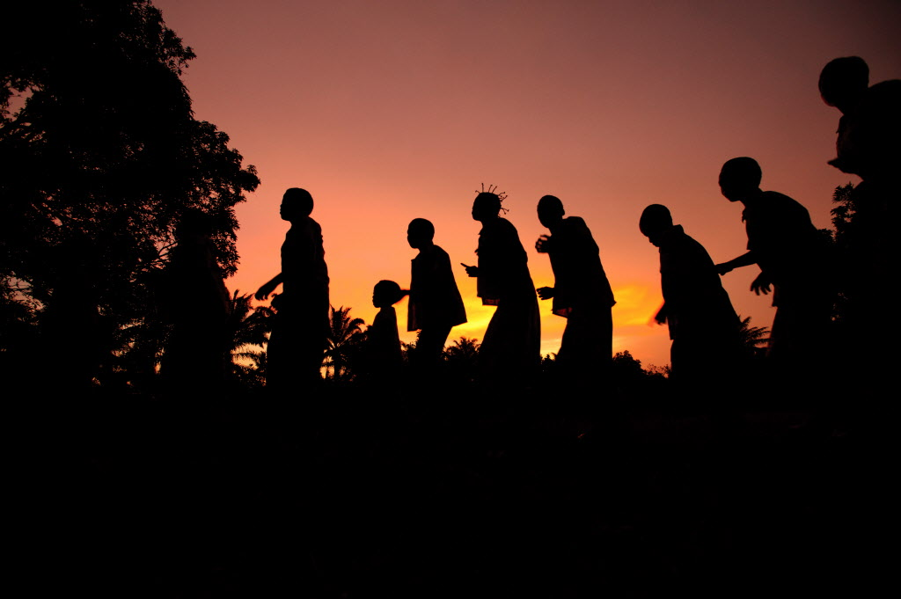
In witness to your saving love, Lord Christ, knit together the people in supportive communities. Through Your Body, the church, empower changed lives and hearts in the Congo so that your faithful will see “… justice roll on like a river, righteousness like a never-failing stream! (Amos 5:24)

Slide 4
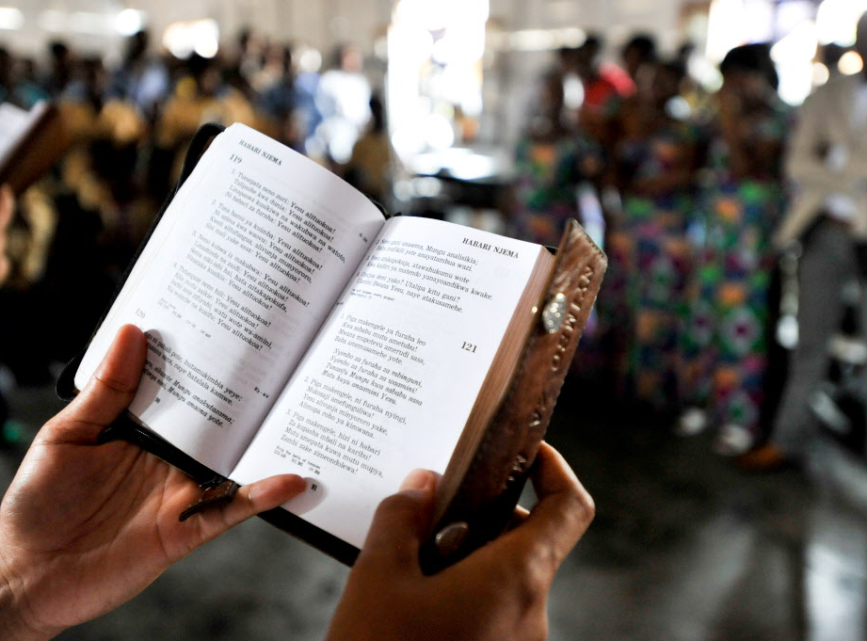
Bless the work of your people in the DRC, Lord. Give your clergy and laity the strength and vision to nurture boys and girls who depend on them. Enable them to provide the example and the learning experiences through which children may reach the potential You gave them. Through child sponsorship and prayer, may we join in bringing light and life to the children of Gemena.

