Slide 2
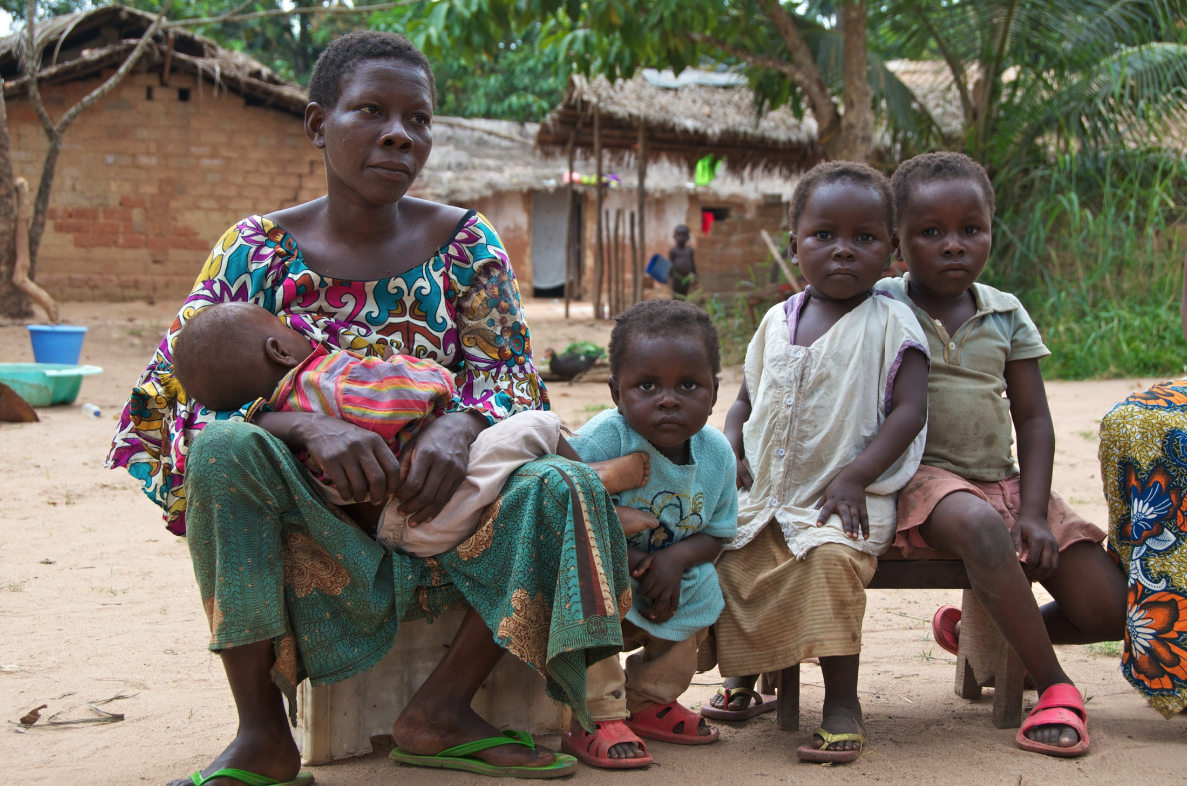
Dear Lord, strengthen the protection of women in the Congo. Lift them up when they fall under the weight of their life’s burdens. Unite churches, community groups, and government leaders to recognize the dignity and worth of women and support their development.

Slide 3
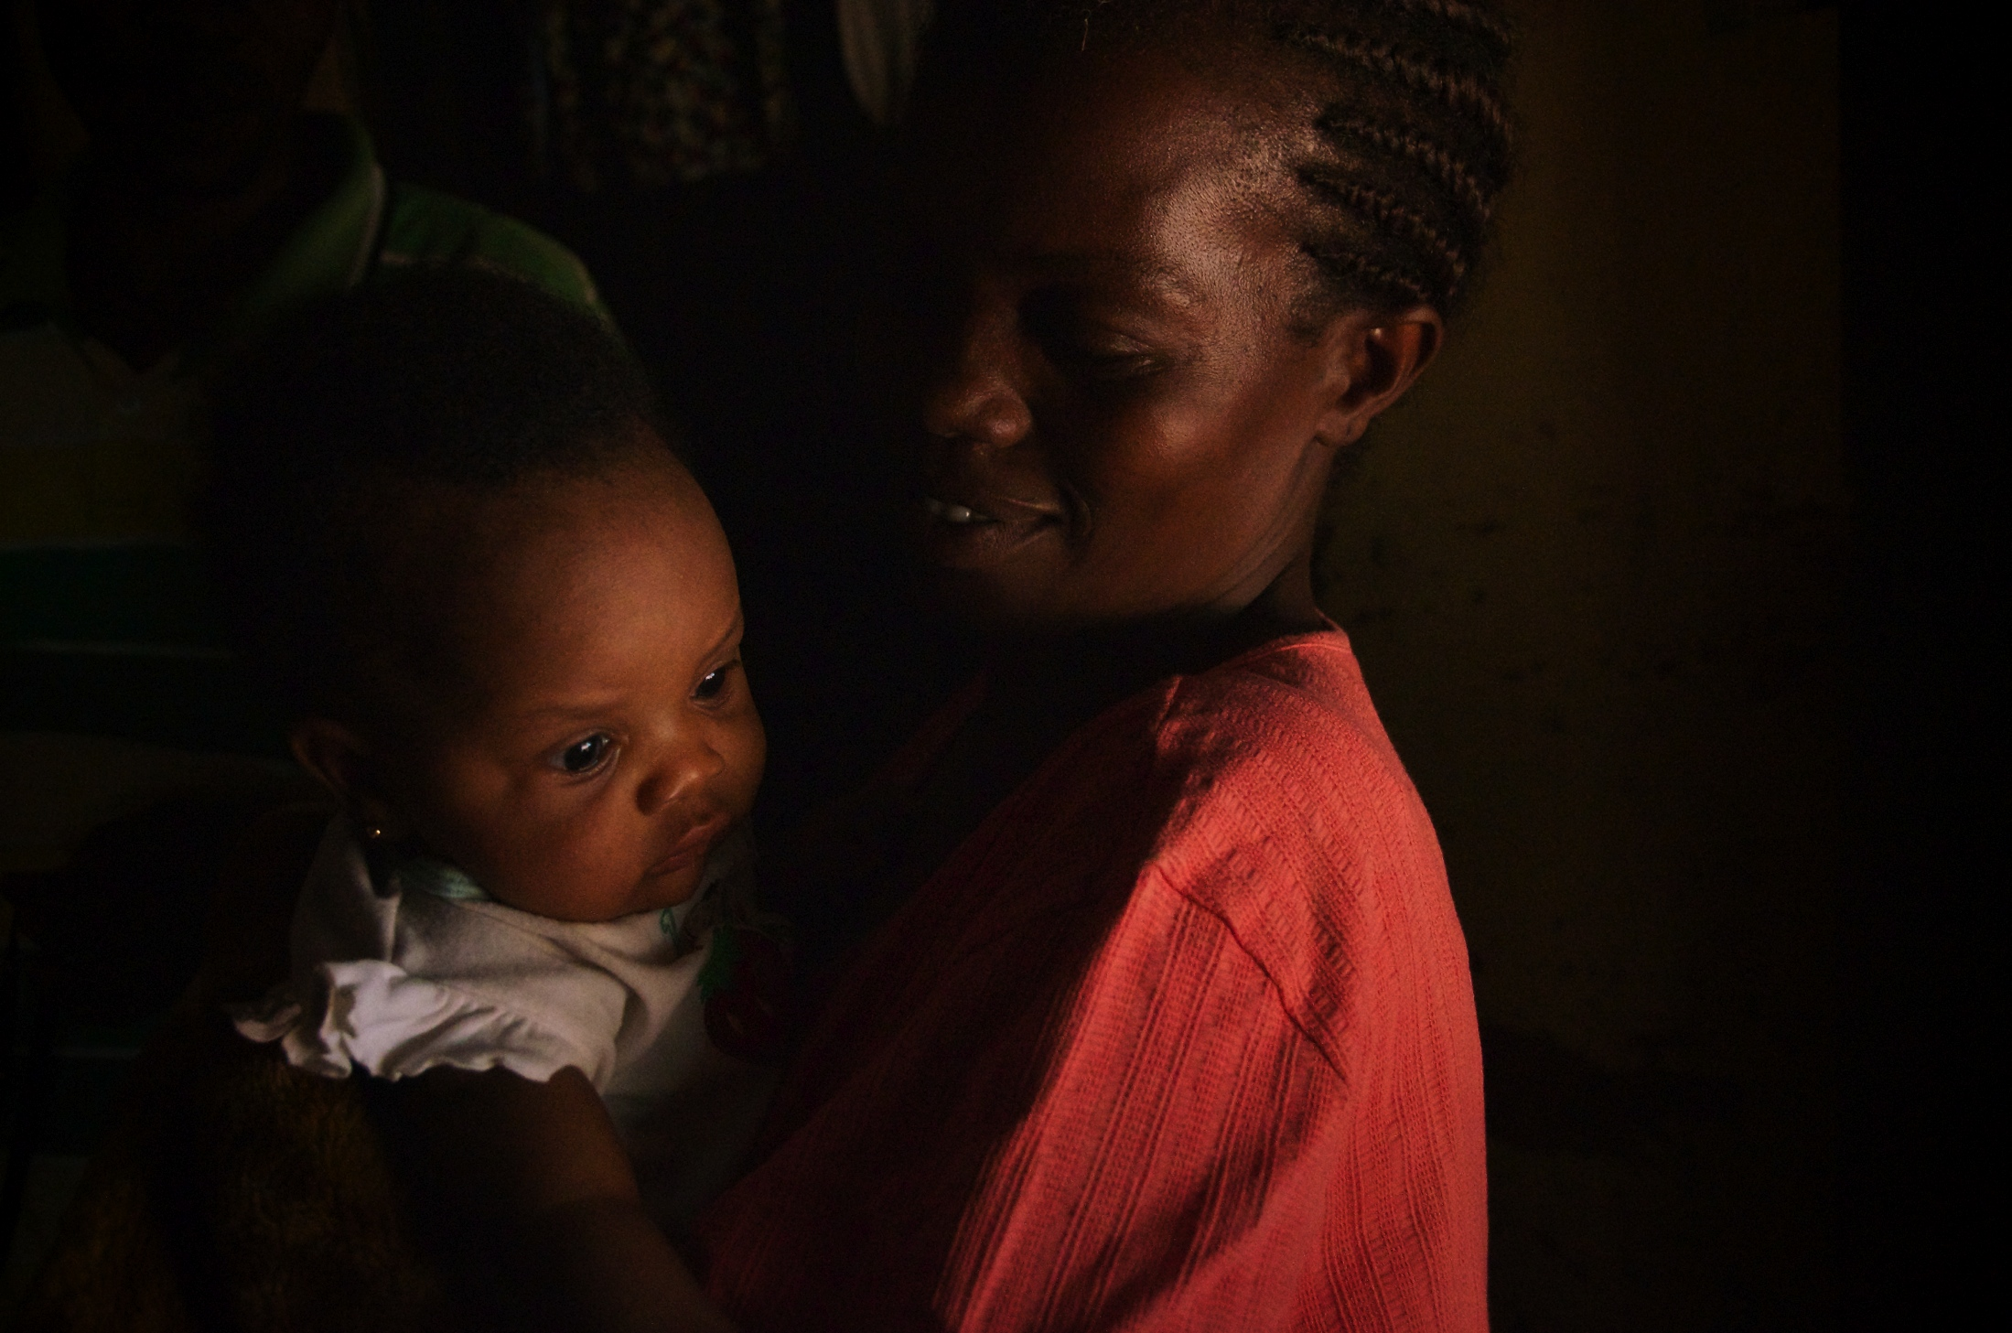
Lord Jesus, in Your life on earth You knew a mother’s love, and on the cross You made provision for Your mother’s care. We pray for the mothers and children of the Congo. Give them the skilled healthcare, nutritious food, and spiritual nurture they need to live a full life.

Slide 4
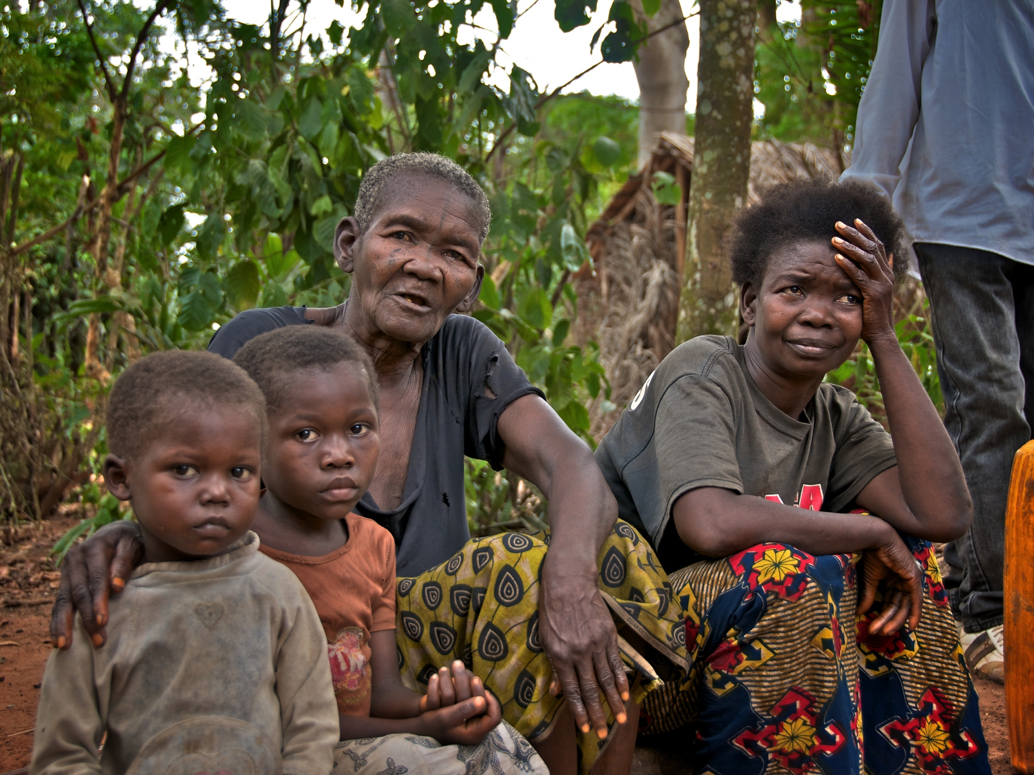
Heavenly Father, bolster the courage and determination of the women of Gemena. Let them see Your hand at work in creating opportunities for them to improve their lives. May they know the joy of seeing their children grow and prosper.

