Slide 1
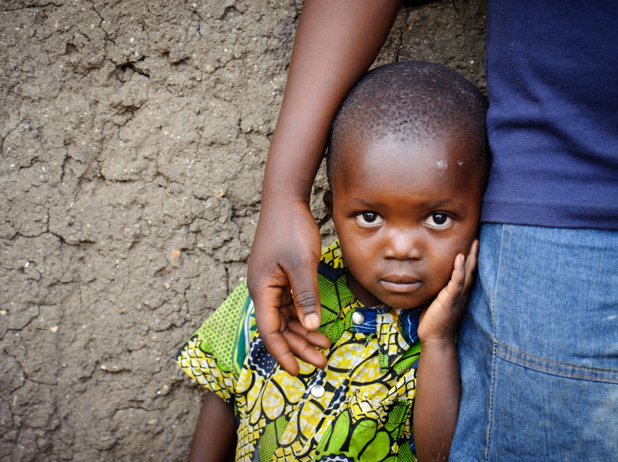



Slide 2
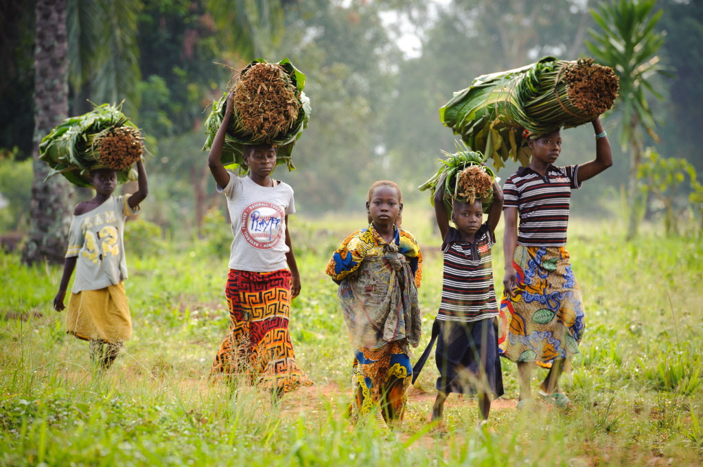
Heavenly Father, You put Adam in the garden “to work it and keep it” (Genesis 2:15). You honor honest labor through Your Word . Give the women and men of Gemena opportunities to develop strong livelihoods so that they can support their children.

Slide 3
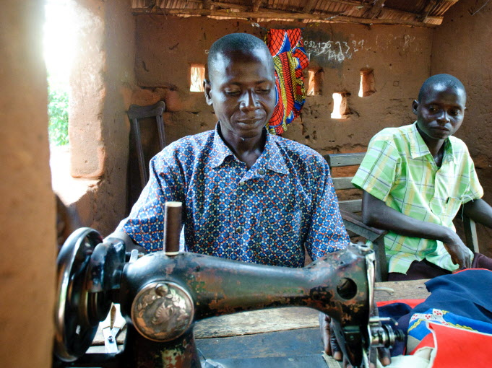
Father, we know that “every good and perfect gift” comes from You. We ask for the gifts of perseverance and hope for the people of Gemena. Help them cooperate to borrow and pay back, to invest in themselves and each other so that they can build strong communities for economic growth and security.

Slide 4
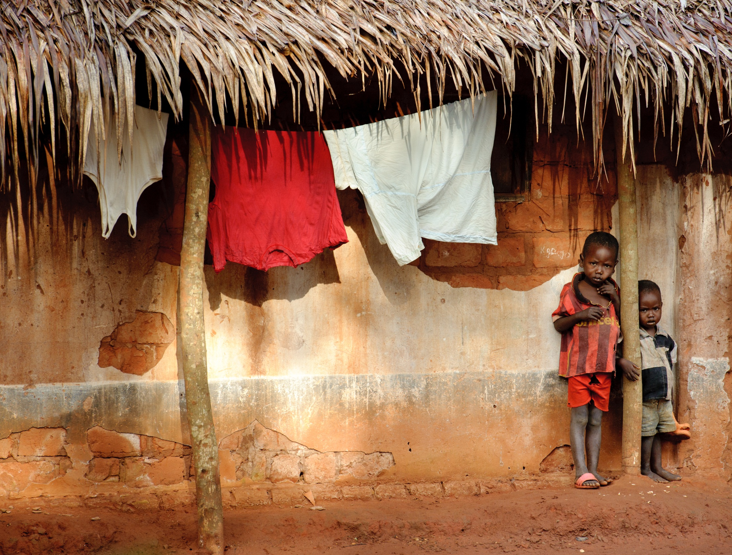
Dear Lord, bless the children of Gemena. Lift the burden of adult cares from their shoulders. May they have good food, loving support from family and friends, and school days filled with joy and learning.

