Slide 1
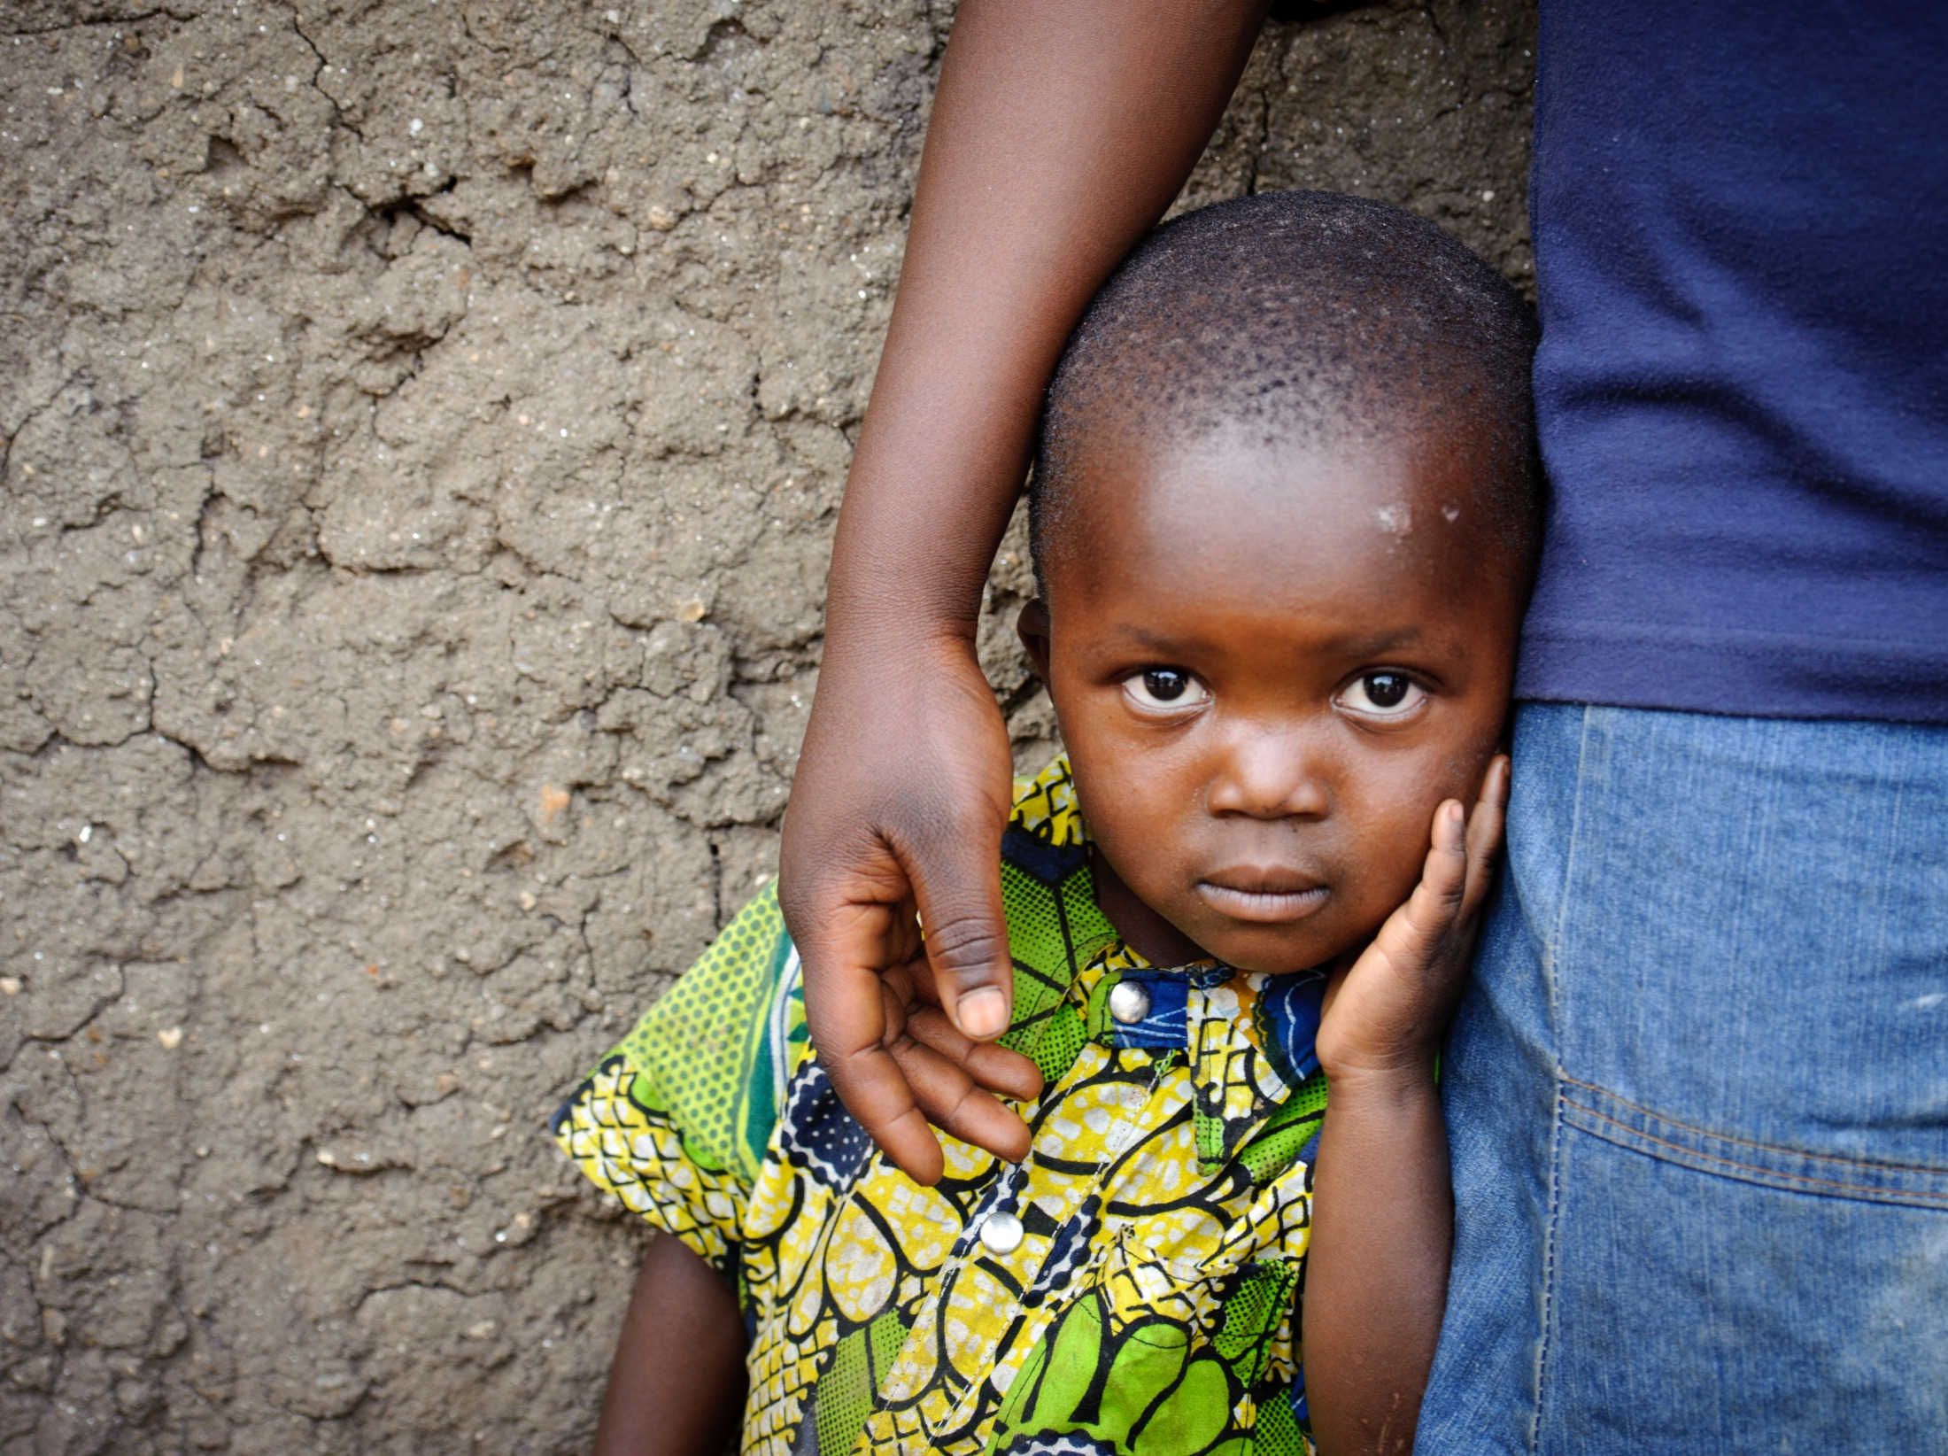

Slide 2
Dear Lord, open our hearts to the children of Gemena so that we may love and care for them as our own. We pray that they may live in safety from ill health, hunger, and want. Inspire us to invest in their future through child sponsorship.

Slide 3
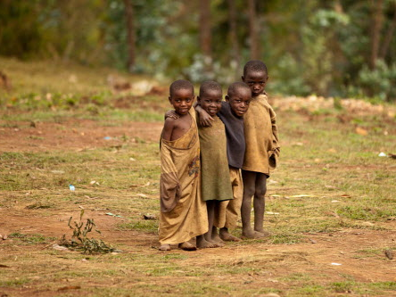
Heavenly Father, You looked over the whole of your creation and saw that it was good. Teach us to recognize the worth in others and reach out to them in understanding and compassion. Show us how we can be a blessing to the people of Gemena.

Slide 4
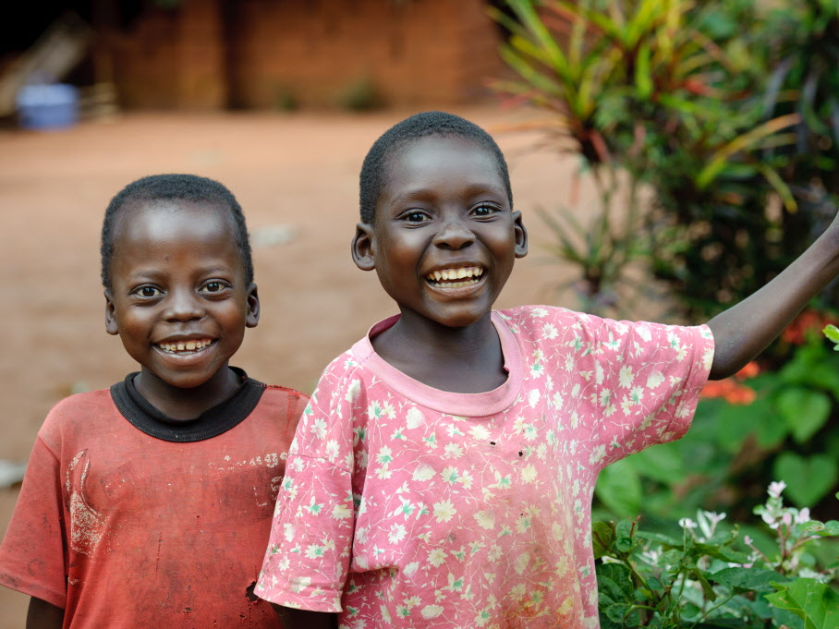
Lord, You came into the world and sacrificed Yourself that we—and the children of the Congo—might have “life in all its fullness” (John 10:10). Inspire us follow Your example so that our lives may be a blessing to others. Make us instruments of Your love to the children of Gemena.

